Slide 1
Monocular Vision Model
Adam Shah

Slide 2
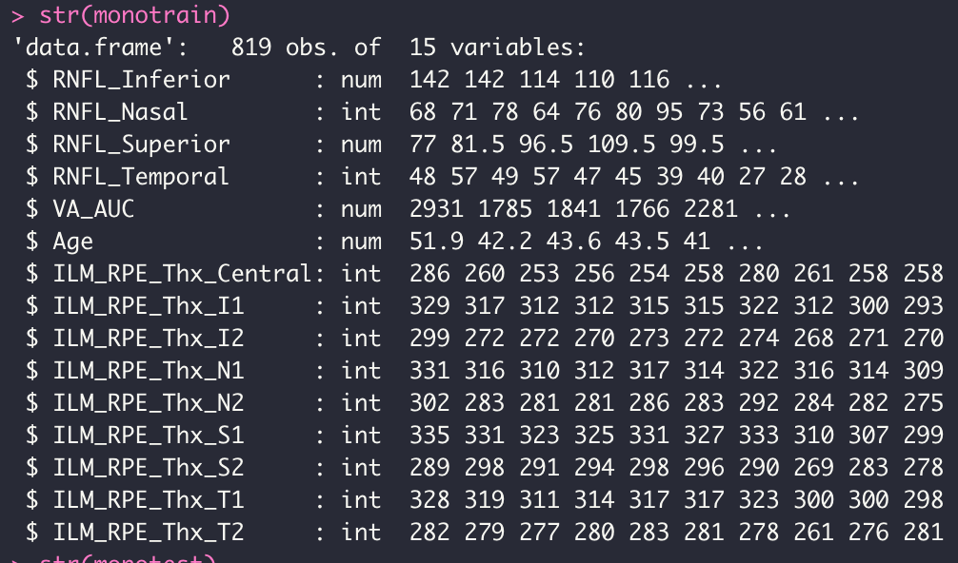
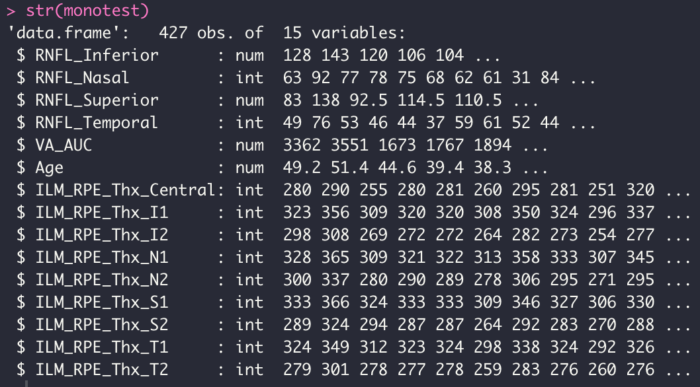
Info about training and testing cohorts
Training data
Testing data

Slide 3
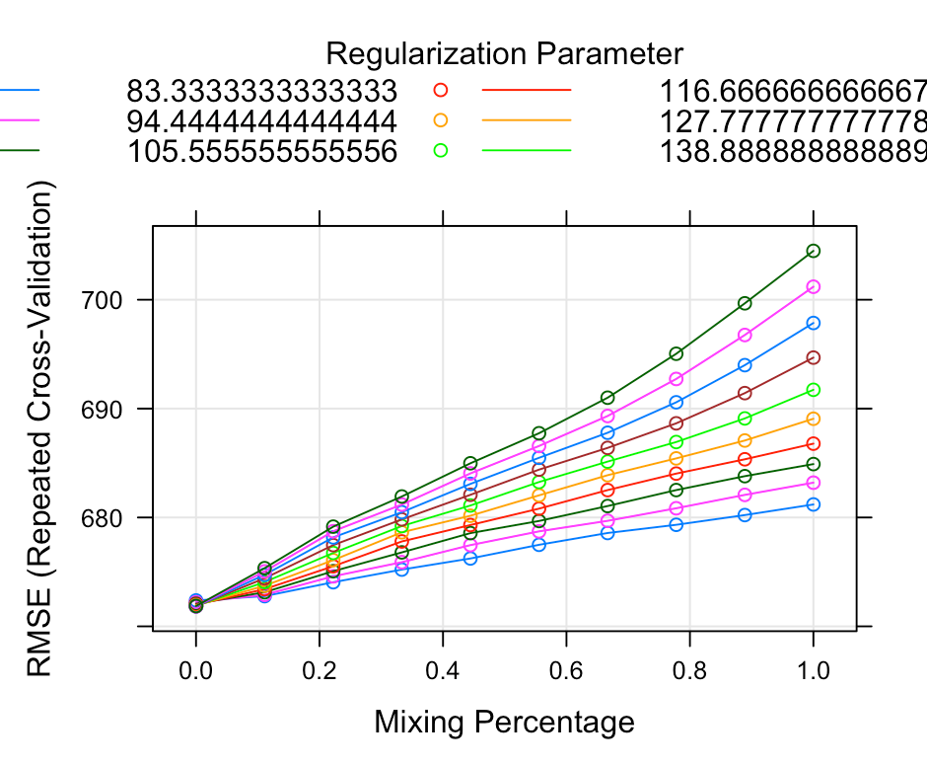
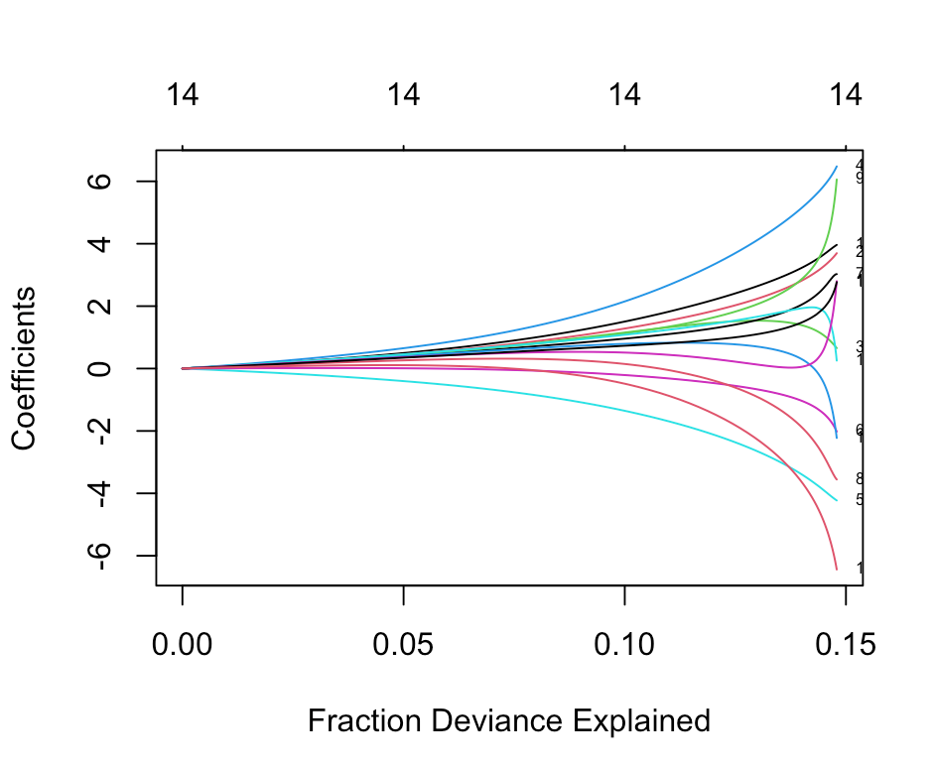
Selecting parameters and variables included
Parameters: alpha = 0 and lambda = 128

Slide 4
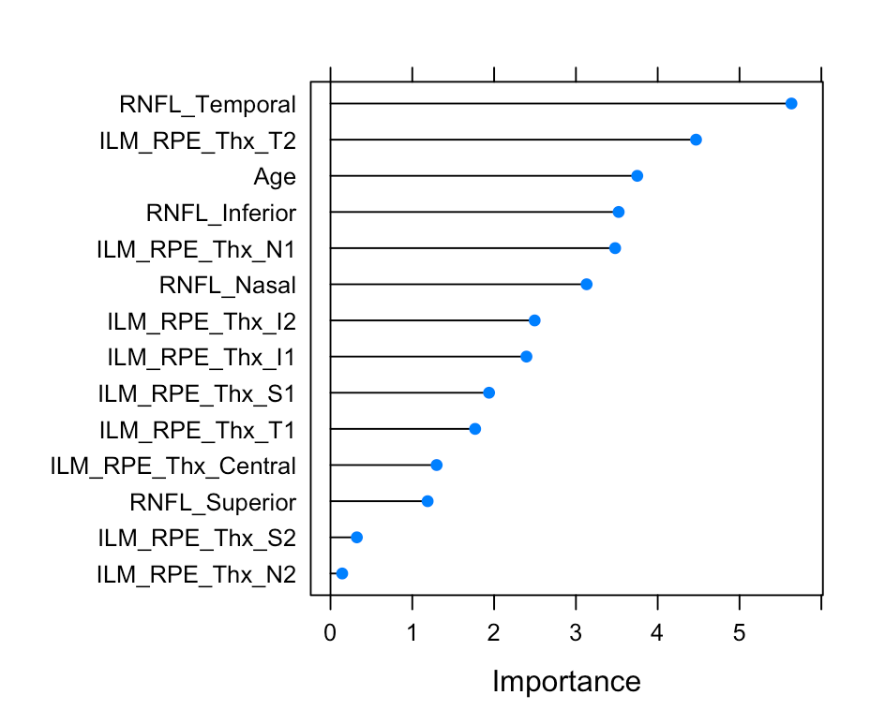
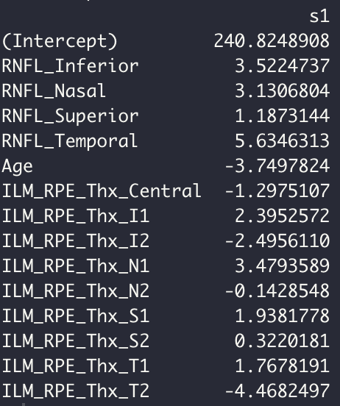
Most important variables and coefficients

Slide 5
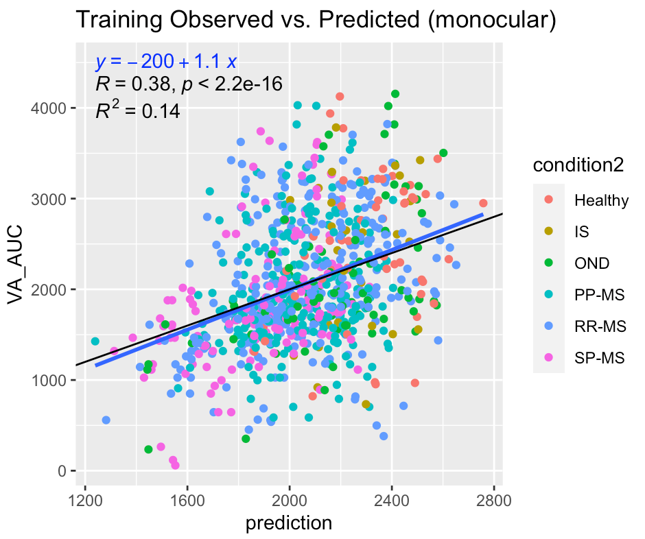
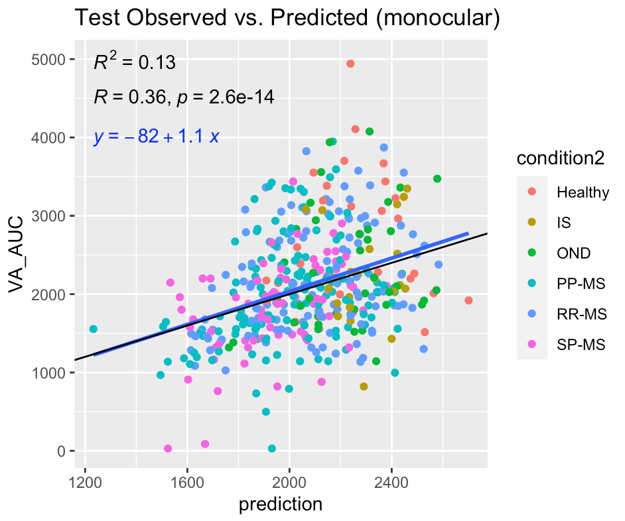
Comparing fit for training and testing data

